Slide 1
Autonomous Car
GRADUATION PROJECT

Slide 2

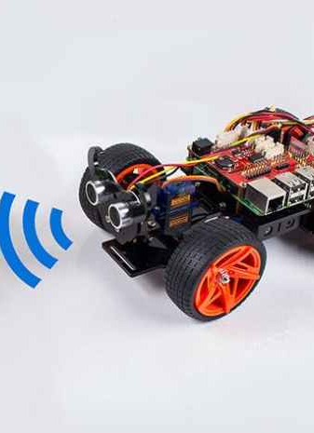
INTRODUCTION
What is an Autonomous Car ?
An autonomous car is a vehicle capable of sensing its environment and operating without human involvement. A human passenger is not required to take control of the vehicle at any time. An autonomous car can go anywhere a traditional car goes and do everything that an experienced human driver does.
This Photo by Unknown author is licensed under CC BY-SA-NC.

Slide 3
Automated vs. Self-Driving: What’s the difference?
A truly self driving car would decide on destination and route as well as control within the lanes. An automated car would follow orders about destination and route, and may only adopt some lane-keeping or car-following guidance. A fully autonomous car would be self-aware and capable of making its own choices.
A real self-driving car would not even require the driver to choose the route, but start the car and drive to the destination while making its own decisions. Although there are many autonomous levels, a self-driving car that completes a journey while solely relying on a complex AI can be viewed as having full autonomy.

Slide 4
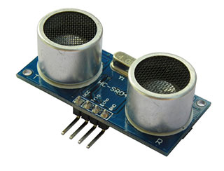
How do autonomous cars work?
Autonomous cars rely on sensors, actuators, complex algorithms, machine learning systems, and powerful processors to execute software.
Autonomous cars create and maintain a map of their surroundings based on a variety of sensors situated in different parts of the vehicle. Radar sensors monitor the position of nearby vehicles. Video cameras detect traffic lights, read road signs, track other vehicles, and look for pedestrians. Lidar (light detection and ranging) sensors bounce pulses of light off the car’s surroundings to measure distances, detect road edges, and identify lane markings. Ultrasonic sensors in the wheels detect curbs and other vehicles when parking.
Sophisticated software then processes all this sensory input, plots a path, and sends instructions to the car’s actuators, which control acceleration, braking, and steering. Hard-coded rules, obstacle avoidance algorithms, and object recognition help the software follow traffic rules and navigate obstacles.
This Photo by Unknown author is licensed under CC BY-SA.

Slide 5
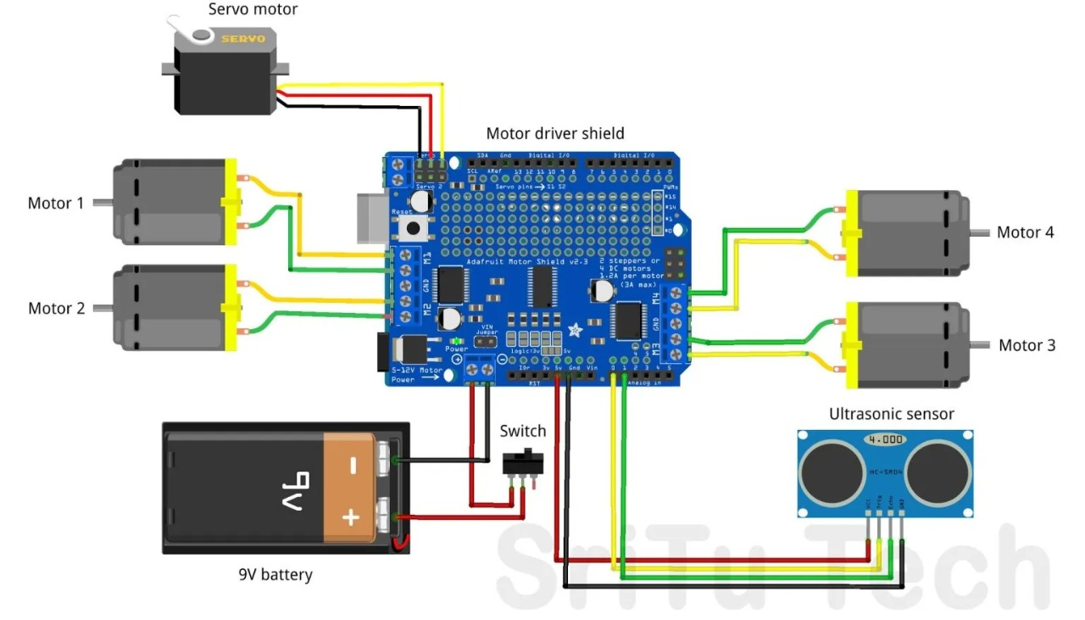
Simulation

Slide 6
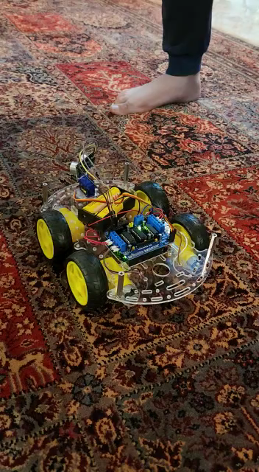
Video for our project

Slide 7
What are the benefits of autonomous cars?
The scenarios for convenience and quality-of-life improvements are limitless. The elderly and the physically disabled would have independence. If your kids were at summer camp and forgot their bathing suits and toothbrushes, the car could bring them the missing items. You could even send your dog to a veterinary appointment.
But the real promise of autonomous cars is the potential for dramatically lowering CO2 emissions. In a recent study, experts identified three trends that, if adopted concurrently, would unleash the full potential of autonomous cars: vehicle automation, vehicle electrification, and ridesharing. By 2050, these “three revolutions in urban transportation” could:
Reduce traffic congestion (30% fewer vehicles on the road)
Cut transportation costs by 40% (in terms of vehicles, fuel, and infrastructure)
Improve walkability and livability
Free up parking lots for other uses (schools, parks, community centers)
Reduce urban CO2 emissions by 80% worldwide

Slide 8
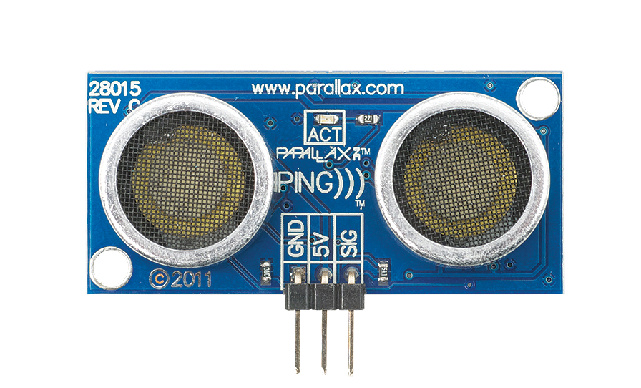
autonomous car components
This Photo by Unknown author is licensed under CC BY-NC.
HC-SR04 Ultrasonic Sensor
How Does HC-SR04 Ultrasonic Distance Sensor Work?
It all starts when the trigger pin is set HIGH for 10µs. In response, the sensor transmits an ultrasonic burst of eight pulses at 40 kHz. This 8-pulse pattern is specially designed so that the receiver can distinguish the transmitted pulses from ambient ultrasonic noise.
These eight ultrasonic pulses travel through the air away from the transmitter. Meanwhile the echo pin goes HIGH to initiate the echo-back signal.
If those pulses are not reflected back, the echo signal times out and goes low after 38ms (38 milliseconds). Thus a pulse of 38ms indicates no obstruction within the range of the sensor .If those pulses are reflected back, the echo pin goes low as soon as the signal is received. This generates a pulse on the echo pin depending on the time taken to receive the signal.

Slide 9

autonomous car components
Servo motor
What Is A Servo Motor?
A servomotor (or servo motor) is a rotary or linear actuator that allows precise control of angular or linear position, velocity, and acceleration. It consists of a suitable motor coupled to a position feedback sensor. Servo motors are used in applications such as robotics, CNC machinery, or automated manufacturing.
It also requires a relatively sophisticated controller, often a dedicated module designed specifically for use with servo motors. Servo motors are not a specific class of motor, although the term servo motor is often used to refer to a motor suitable for use in a closed-loop control system.
Servo motors are part of a closed-loop control system and consist of several parts, namely a control circuit, a servo motor, a shaft, a potentiometer, a drive gear, an amplifier, and either an encoder or a resolver. A servomotor is a self-contained electrical device that rotates parts of a machine with high efficiency and great precision.
This Photo by Unknown author is licensed under CC BY-SA.

Slide 10

autonomous car components
L293D motor driver
What is L293D motor driver?
The L293D is designed to provide bidirectional drive currents of up to 600-mA at voltages from 4.5 V to 36 V. Both devices are designed to drive inductive loads such as relays, solenoids, DC and bipolar stepping motors, as well as other high-current/high-voltage loads in positive-supply applications.
This Photo by Unknown author is licensed under CC BY-SA.

Slide 11
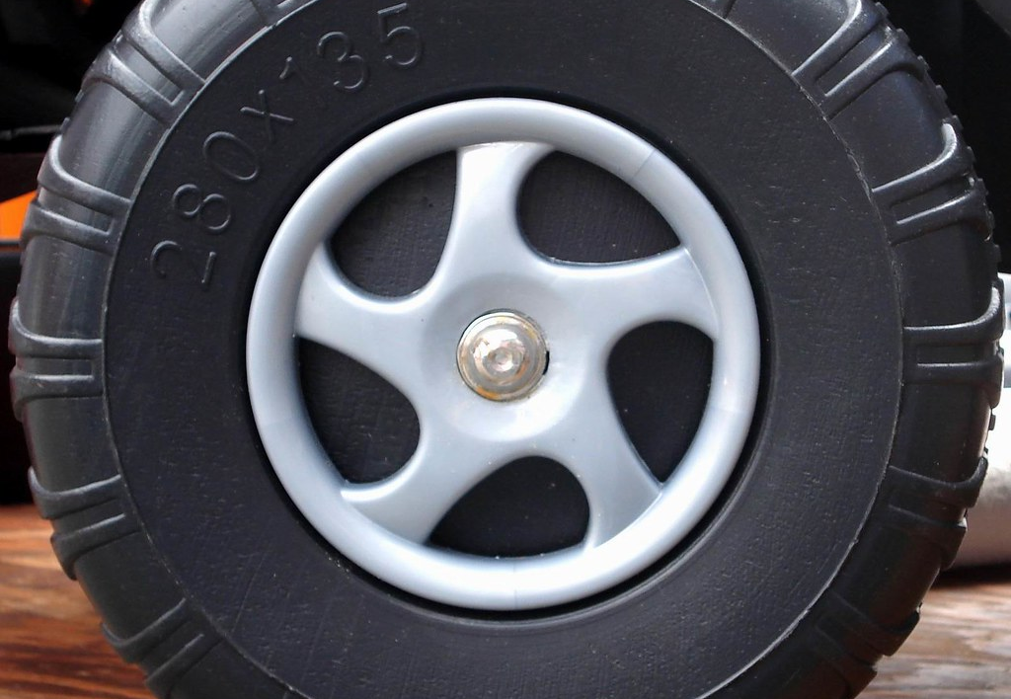
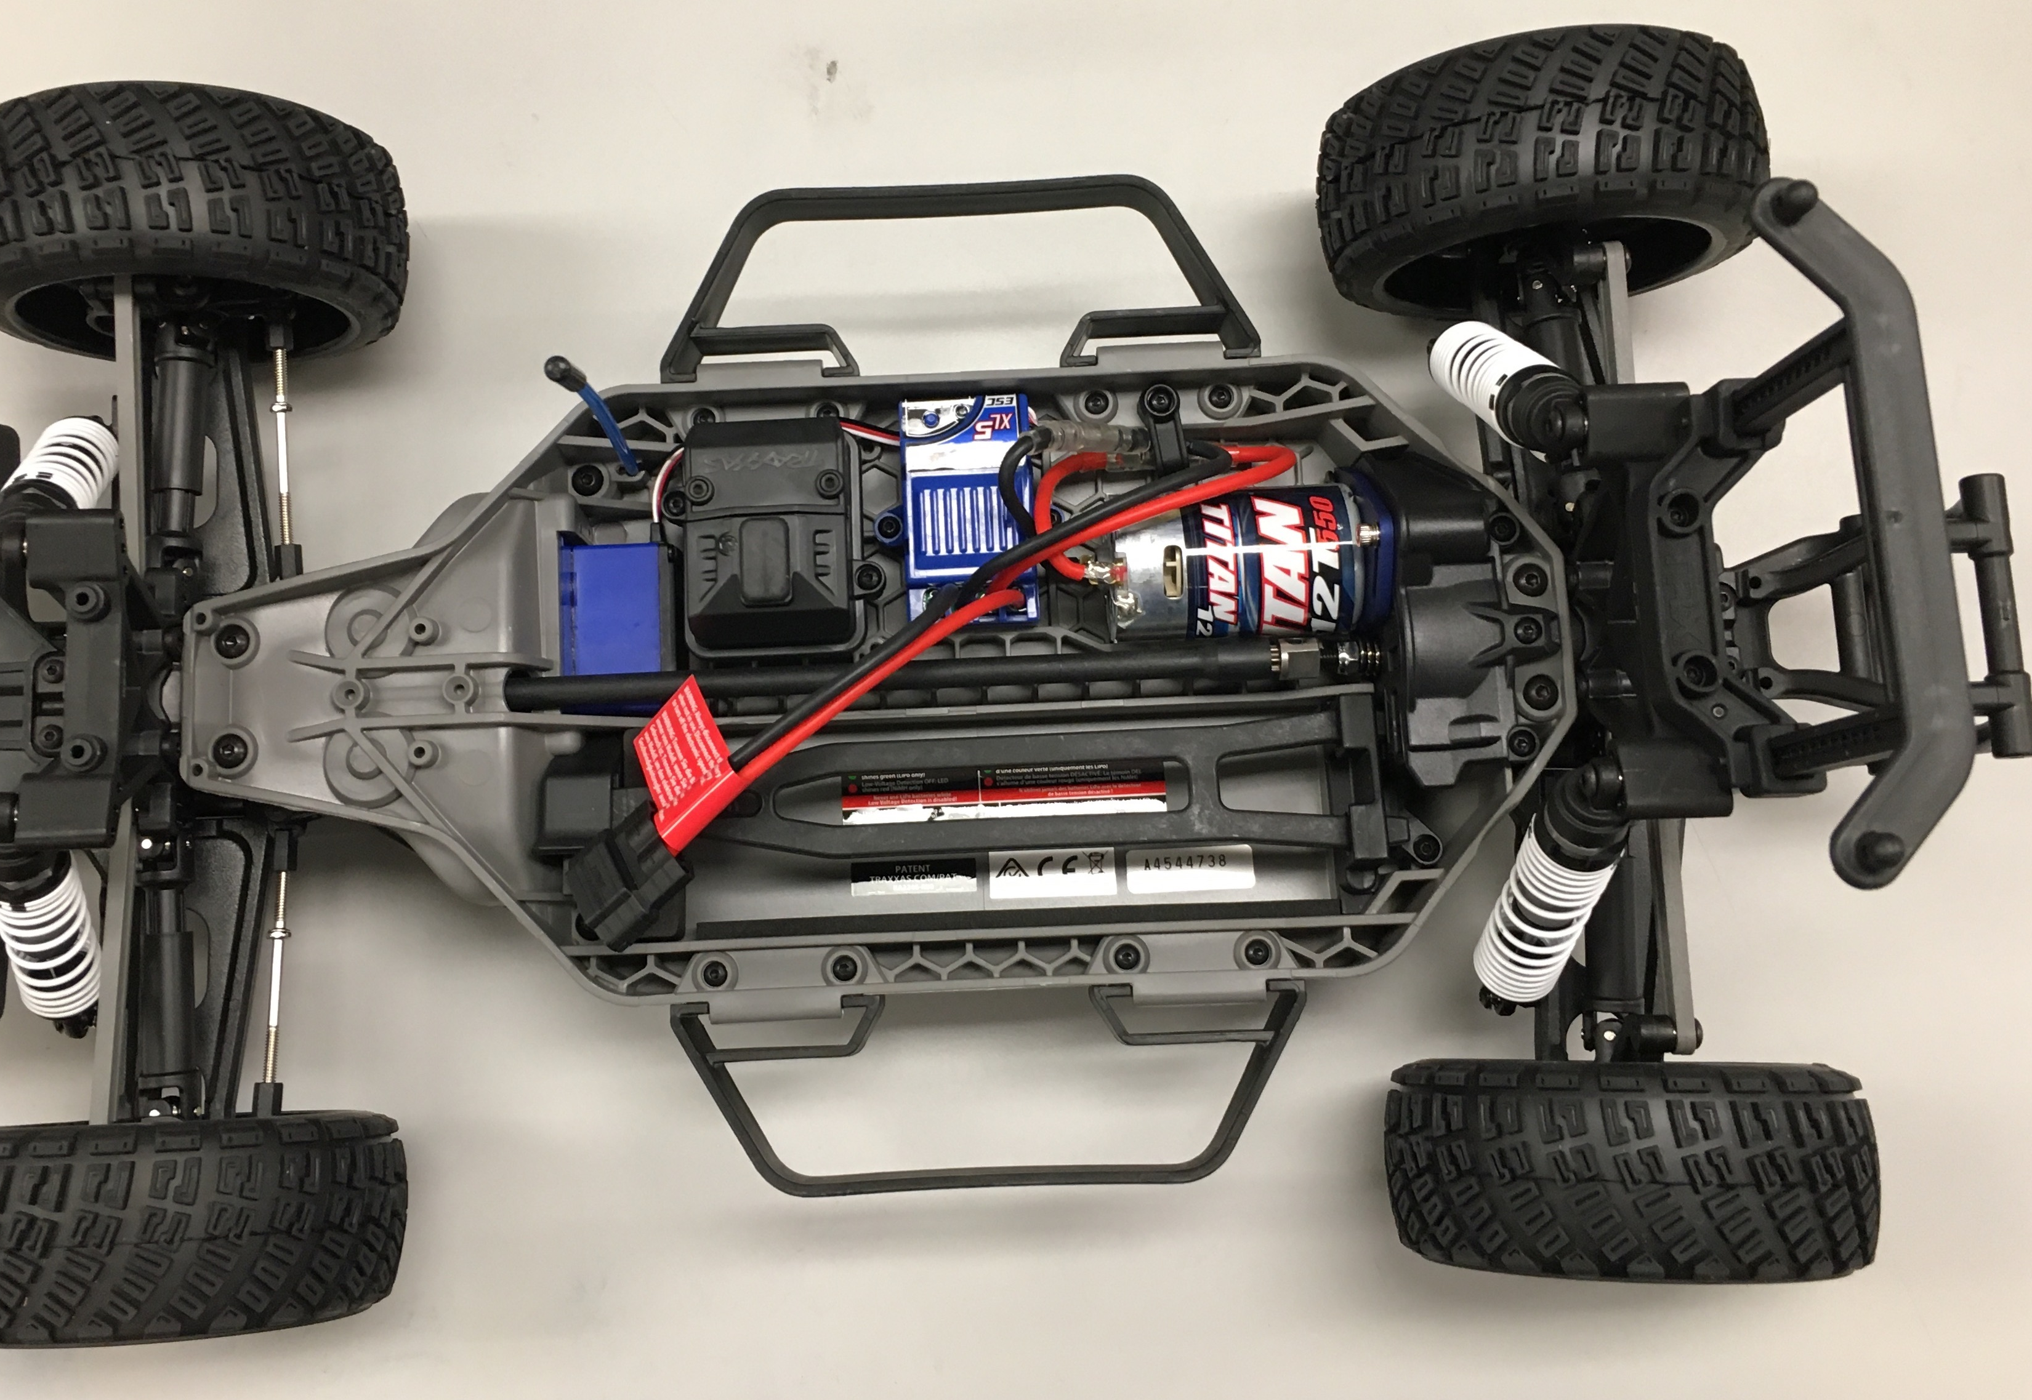
autonomous car components
Motors , caster wheel and chassis
This Photo by Unknown author is licensed under CC BY-SA-NC.
This Photo by Unknown author is licensed under CC BY-SA-NC.

Slide 12
What are the challenges with autonomous cars?
Fully autonomous cars are undergoing testing in several pockets of the world, but none are yet available to the general public. We’re still years away from that. The challenges range from the technological and legislative to the environmental and philosophical. Here are just some of the unknowns.
Lidar and Radar
Lidar is expensive and is still trying to strike the right balance between range and resolution. If multiple autonomous cars were to drive on the same road, would their lidar signals interfere with one another? And if multiple radio frequencies are available, will the frequency range be enough to support mass production of autonomous cars?

Slide 13
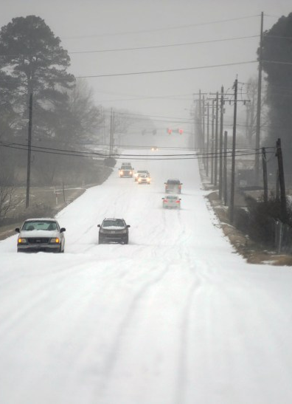
What are the challenges with autonomous cars?
Weather Conditions
What happens when an autonomous car drives in heavy precipitation? If there’s a layer of snow on the road, lane dividers disappear. How will the cameras and sensors track lane markings if the markings are obscured by water, oil, ice, or debris?
This Photo by Unknown author is licensed under CC BY-ND.

Slide 14
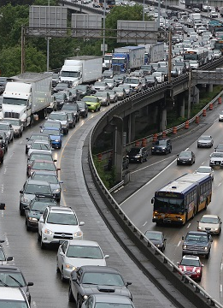
What are the challenges with autonomous cars?
Traffic Conditions and Laws
Will autonomous cars have trouble in tunnels or on bridges? How will they do in bumper-to-bumper traffic? Will autonomous cars be relegated to a specific lane? Will they be granted carpool lane access? And what about the fleet of legacy cars still sharing the roadways for the next 20 or 30 years?
This Photo by Unknown author is licensed under CC BY.

Slide 15
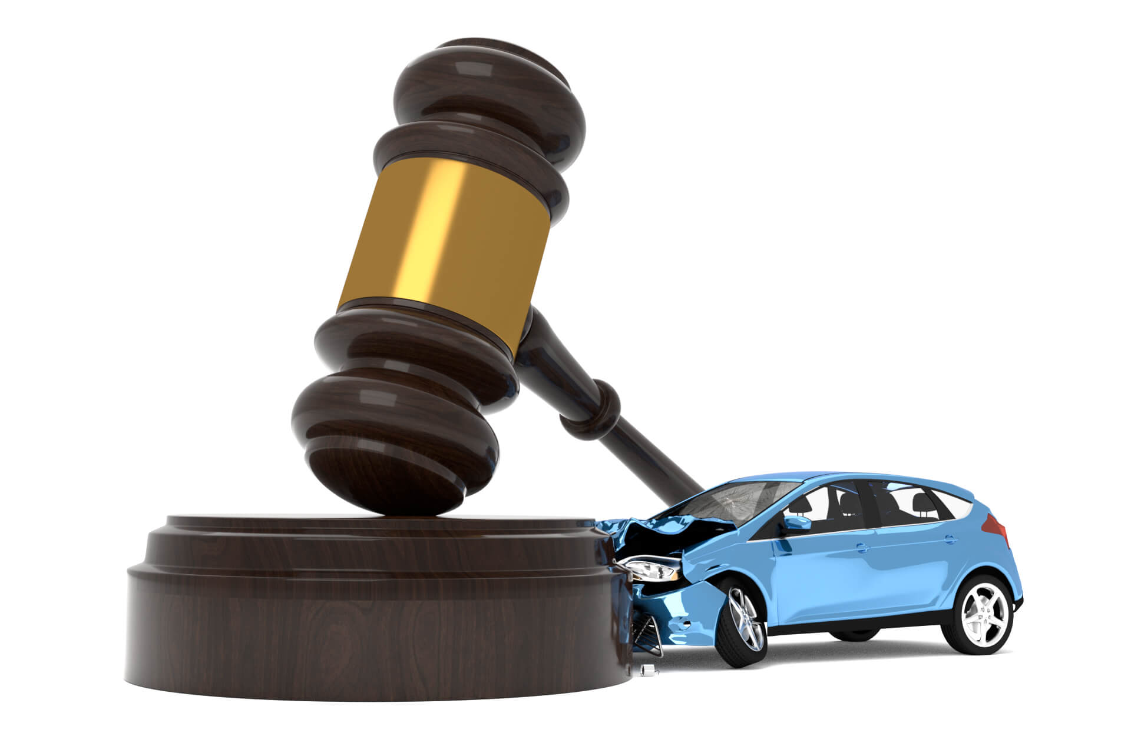
What are the challenges with autonomous cars?
Accident Liability
Who is liable for accidents caused by an autonomous car? The manufacturer? The human passenger? The latest blueprints suggest that a fully autonomous Level 5 car will not have a dashboard or a steering wheel, so a human passenger would not even have the option to take control of the vehicle in an emergency.
This Photo by Unknown author is licensed under CC BY-ND.

Slide 16
What are the challenges with autonomous cars?
Artificial vs. Emotional Intelligence
Human drivers rely on subtle cues and non-verbal communication—like making eye contact with pedestrians or reading the facial expressions and body language of other drivers—to make split-second judgment calls and predict behaviors. Will autonomous cars be able to replicate this connection? Will they have the same life-saving instincts as human drivers?

Slide 17
References:
Ballay, M., Macurová, Ľ., Kohút, P., Čopiak, M., 2018. Development of road safety status and the evaluation criterion causes of specific traffic
accidents. In 22nd International Scientific Conference – Transport Means 2018. 03–05. October 2018. Kaunas, Lithuania, 765–770. ISSN
1822-296X
Stiller, C., Ozguner, U., Redmill, K., 2007. Systems for Safety and Autonomous Behaviors in cars: The DARPA challenge experience.
Chang, Y.P., Liu, Ch.N., Pei, Z., et al., 2019. New scheme of LiDAR-embedded smart laser headlight for autonomous vehicles. OPTICS
EXPRESS 27.20, A1481–A1489.
Gerstmair, M., Melzer, A., Onic, A., et al., 2019. On the Safe Road Toward Autonomous Driving Phase noise monitoring in radar sensors for
functional safety compliance. IEEE SIGNAL PROCESSING MAGAZINE 36.5, 60–70.
Jurecki, R., Poliak, M., Jaskiewicz, M., 2017. Young adult drivers: simulated behaviour in a car-following situation, Promet-Traffic &
Transportation 29.4, 381–390. ISSN 0353-5320.
Kalašová, A., Ondruš, J., Kubíková, S., 2018. Inteligentné dopravné systémy, 1. ed. Žilina: Žilinská univerzita v Žiline, Slovakia, 302 p. ISBN
978-80-554-1493-5.

Slide 18


